Slide 1
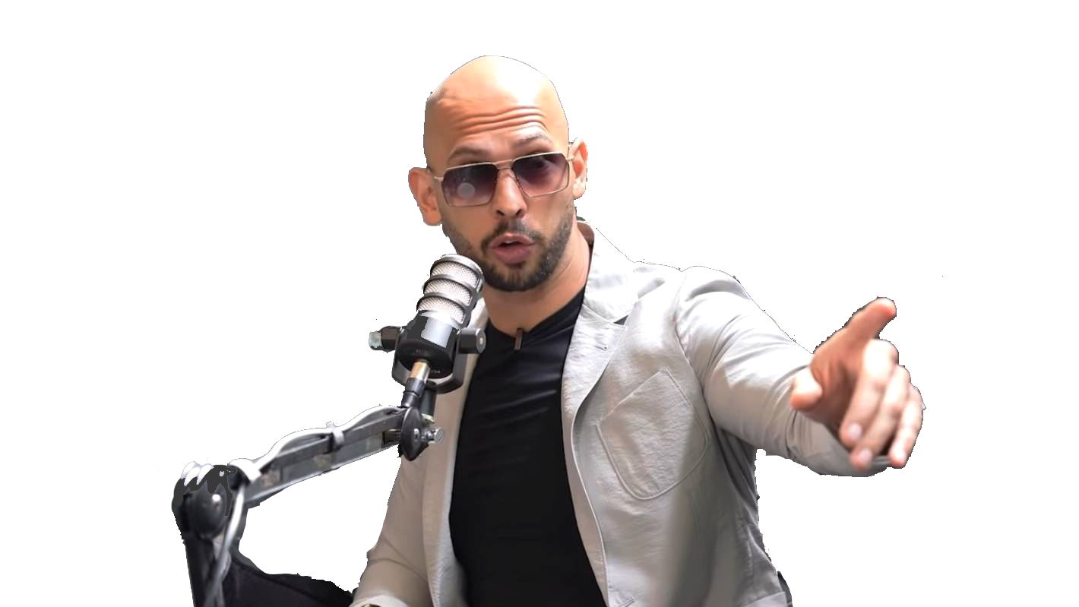
Masculinity Survey
Another CART451 presentation by Madeline and Cassandra

Slide 2
What is the Masculinity Survey dataset?
Conducted from May 10 to 22 2018
Last update made 10 months ago
FiveThirtyEight and WNYC studios partner up with MonkeySurvey to ask this question to men: What does it all mean for how men feel about being men?
Contains 1,615 results of adult men answering various questions related to masculinity
Reflects men’s vision of masculinity, workplace culture and intimacy
Questions: importance of masculinity, influences on masculinity, lifestyle, concerns, relationships in the workplace, dating habits, and thoughts on #metoo movement
Used for feminist and gender equality purposes, can serve activists and social causes for improving women's conditions and rights

Slide 3
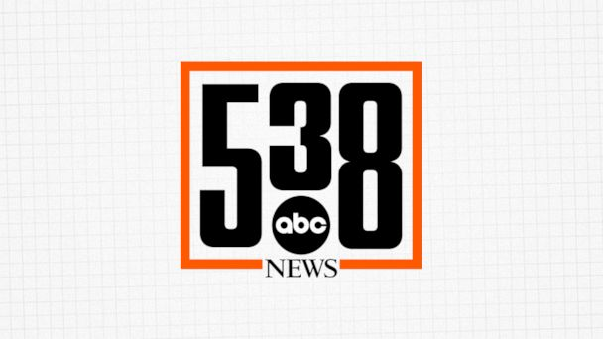

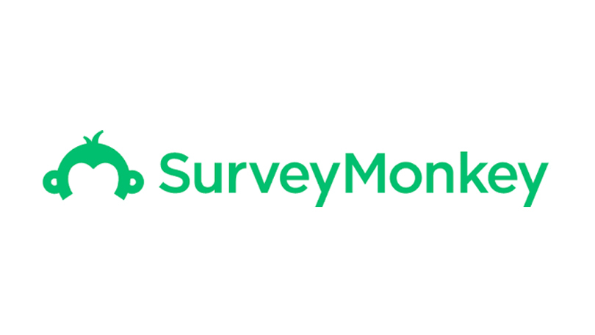
Who is behind the dataset?
FiveThirtyEight (AKA 538)
Brought by ABC News, 538 is an American website focusing on opinion poll analysis, politics, economics, and sports in the United States
Death, Sex & Money
Animated by Anna Sale, this WNYC Studios’ podcast explores big questions and hard choices that are often taboo
SurveyMonkey
Online free form creation platform providing multiple form templates

Slide 4
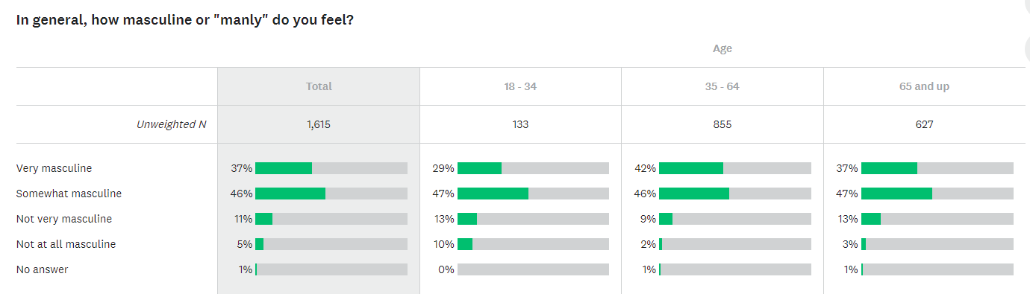
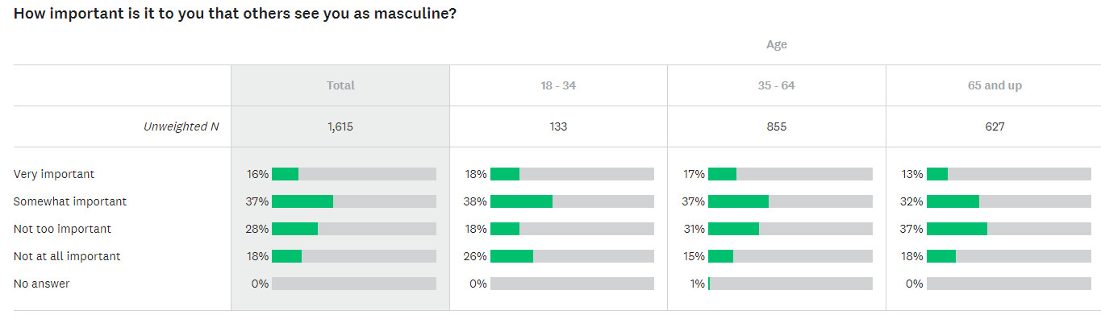
FiveThirtyEight article’s What Do Men Think It Means To Be A Man?

Slide 5
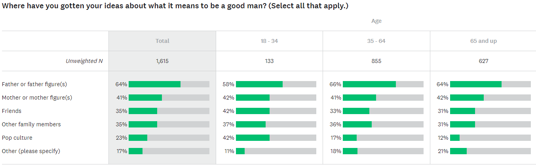
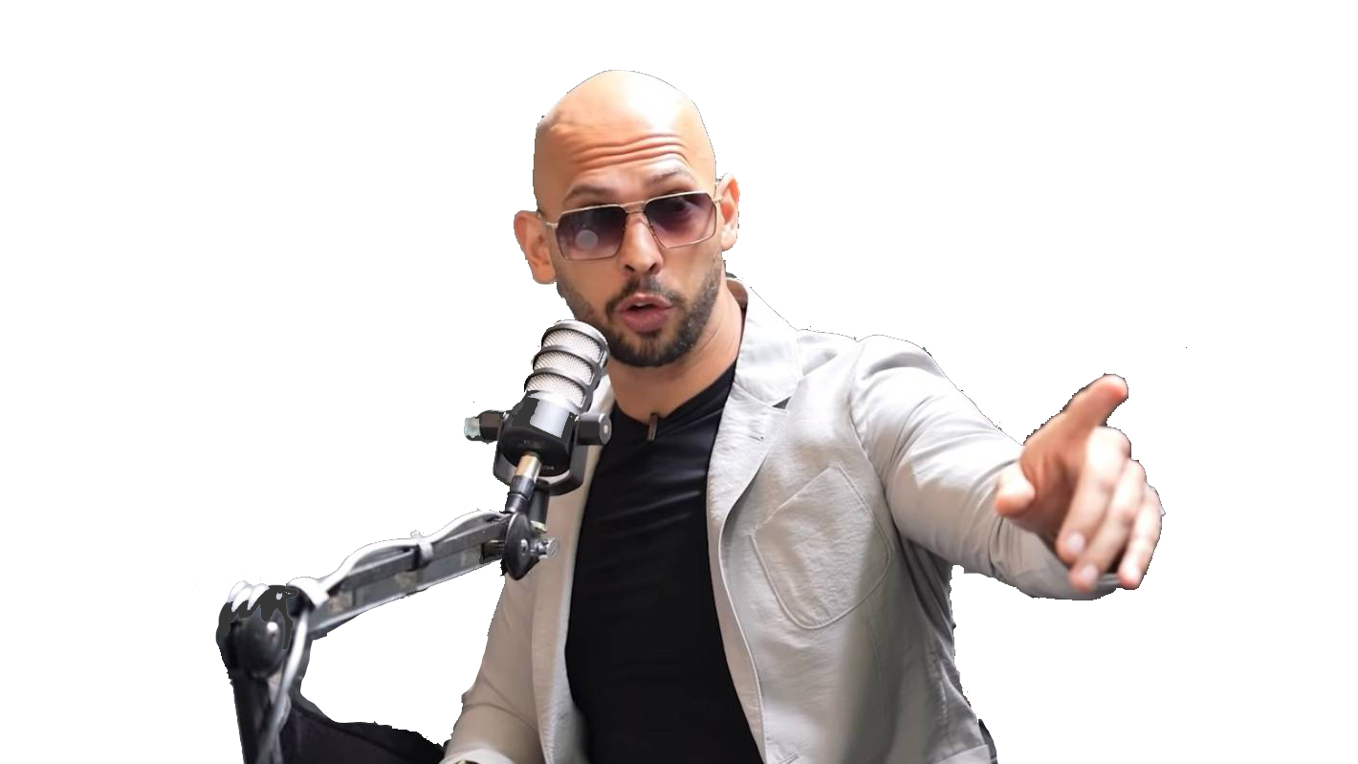

Slide 6
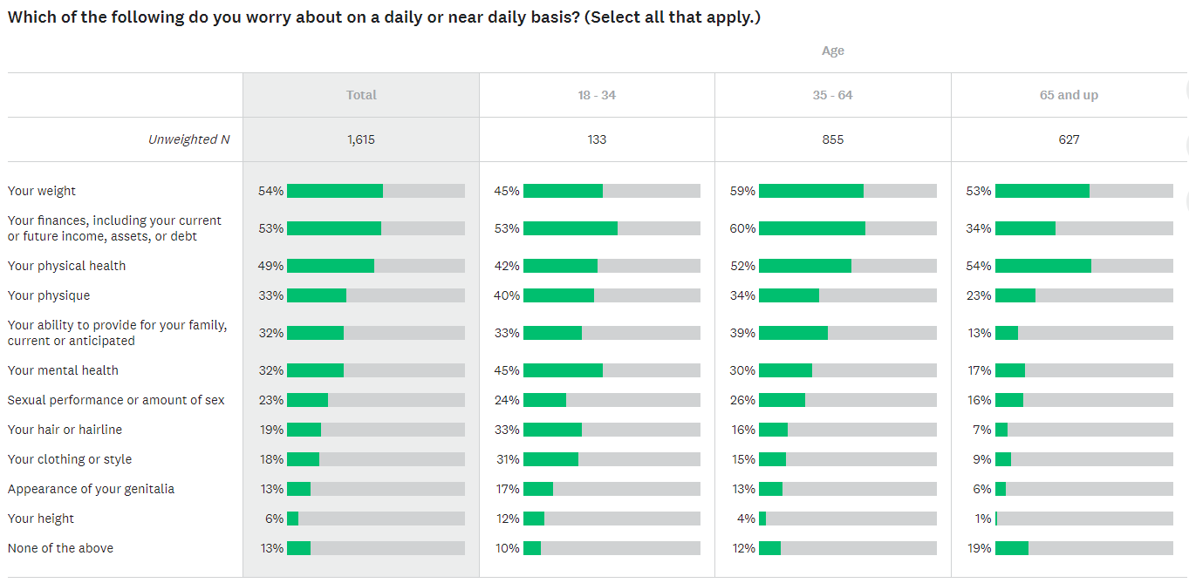

Slide 7
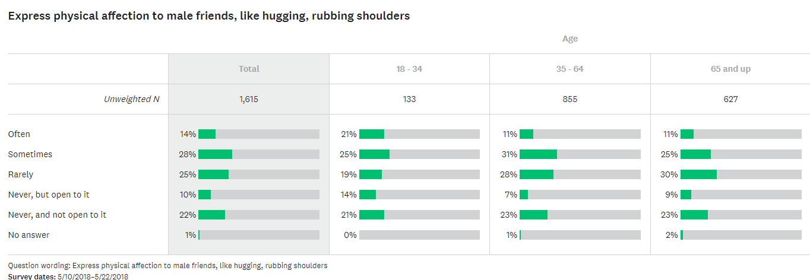
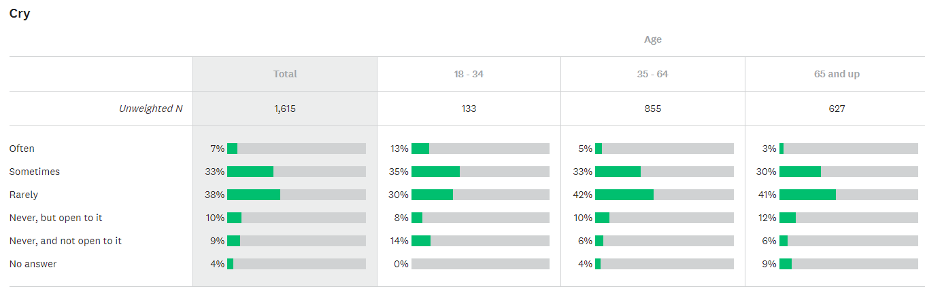
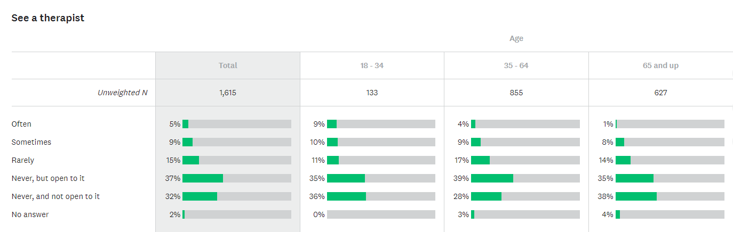

Slide 8
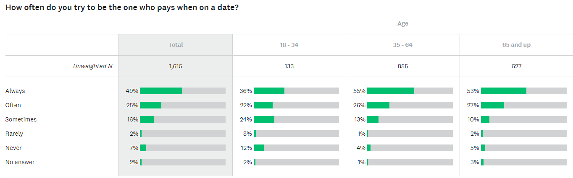
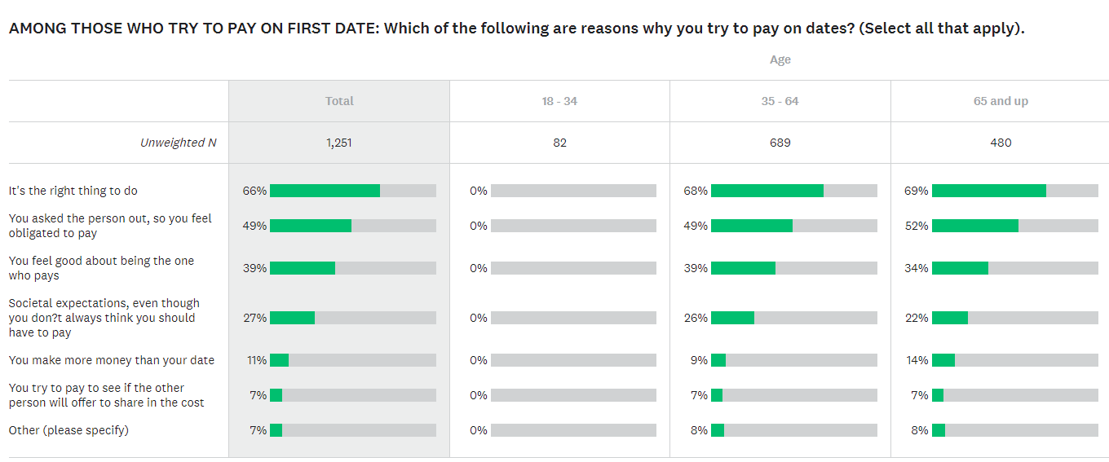

Slide 9
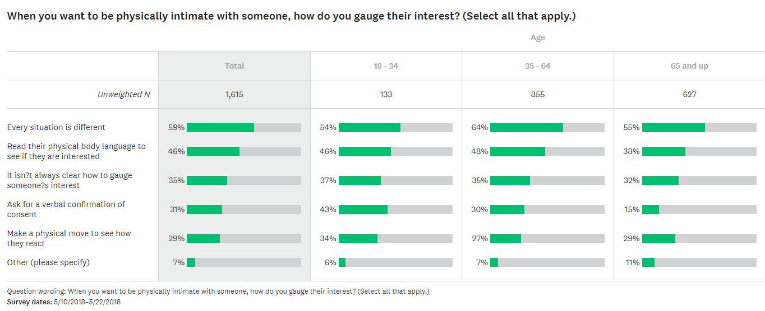
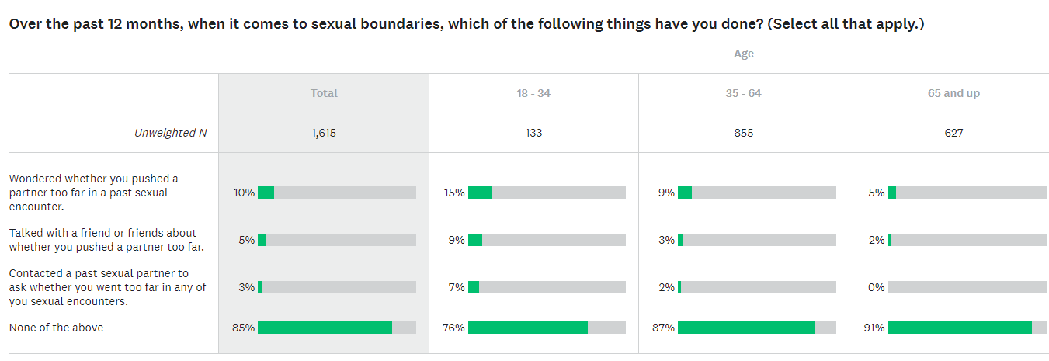

Slide 10
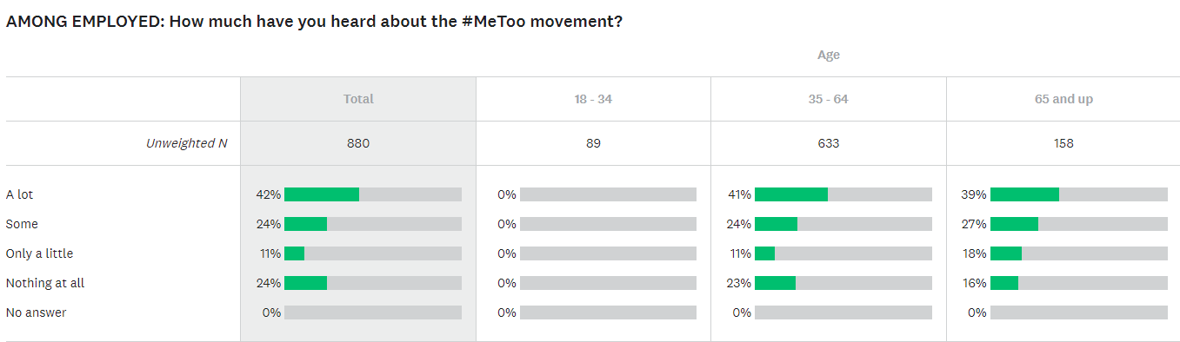
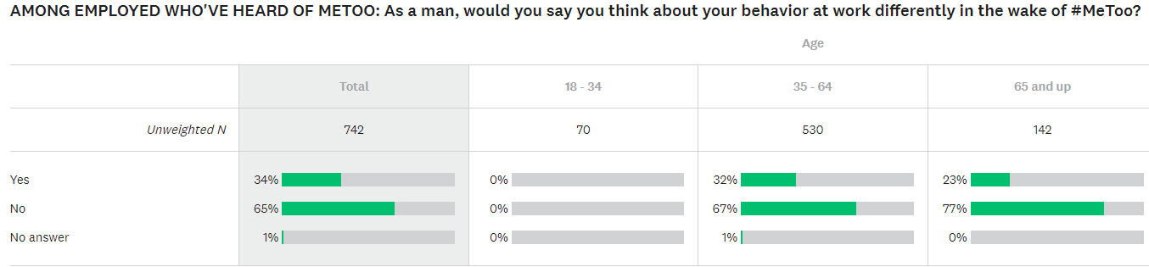
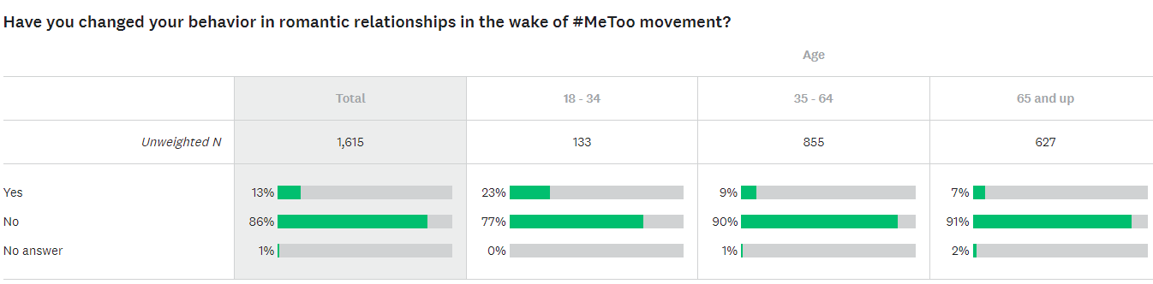

Slide 11
Manhood,Now by Death, Sex & Money podcast
Discuss with the audience about various aspects of manhood and the practices not conform to their gender norms (stay-at-home fathers, mothers being the bread-winner, intergender friendships, sports culture, comedy club culture,etc)
Anyone could participate by calling the podcast station during the episode
Not focusing on the statistics, but deep conversations about the subject

Slide 12
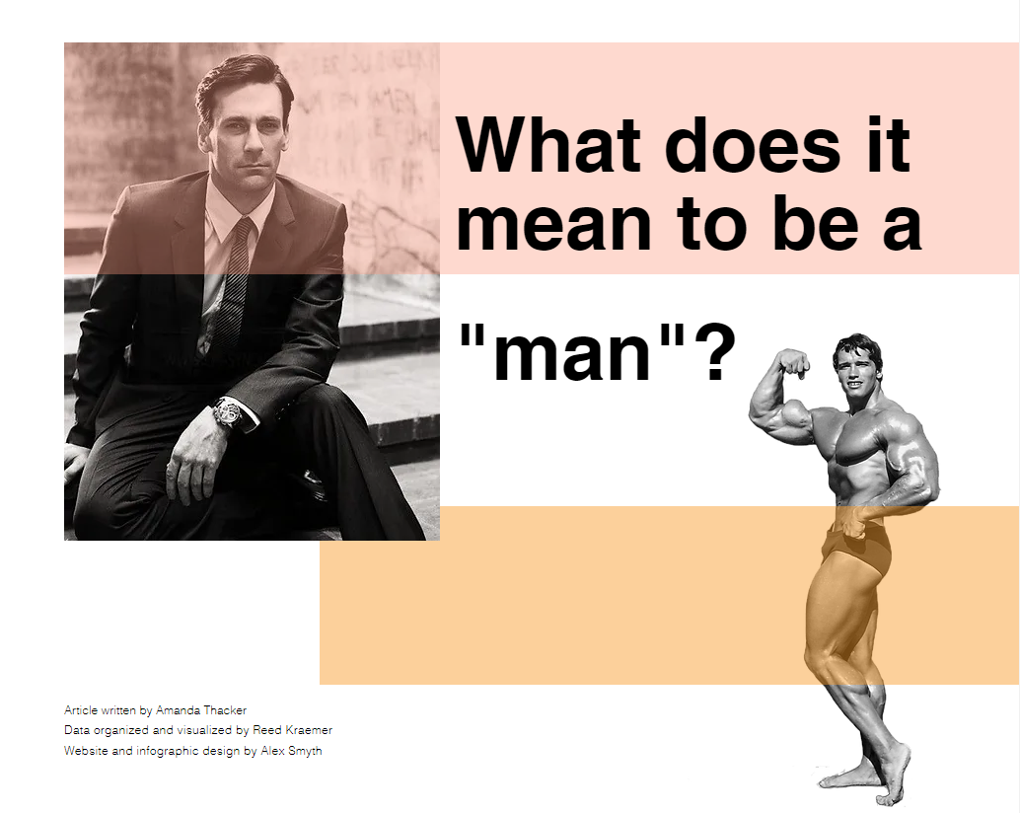
What Does it Mean to Be a ‘Man’? by Amanda Thacker
Made in collaboration with Media Studies students from the University of British Columbia
Data visualization made by Reed Kraemer
Dissection of masculinity and its associated social behaviors and attitudes in the wake of #MeToo, based on FiveThirtyEight’s survey, analyzed and compared with ideas of contemporary gender theorists, scholars, and sociologists
The Project

Slide 13
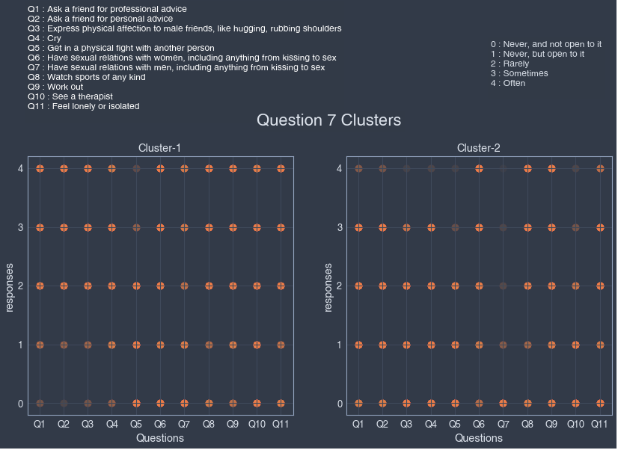
Masculinity Project by Alejandro Ricciardi
Python project about finding patterns in the way men view masculinity utilizing the KMeans clustering algorithm on the FiveThirtyEight survey
KMeans clustering algorithm: Algorithm that identifies the k number of centroids (i.e., an imaginary or real location representing the center of the cluster) and allocates every data point to the nearest cluster, while keeping the centroids as small as possible
The Project

Slide 14
What renders this dataset special?
Survey done during #metoo movement wave
Make a survey and a podcast episode about the subject
Unique way to approach women's rights and gender inequality, asked personal views from men about the issues and their daily lives

Slide 15
In what ways is the dataset problematic?
Survey was made 5 years ago
Does not include all age gaps, it only focuses on the view of American men, the survey was not provided in other countries
There is still approximately a 2.5% chance of error for this model
Only 1615 American men over 18 answered this survey, and only if they wanted to
Responses to open-ended questions have been omitted from the dataset, and the same goes for the answers written in the “other” option, the creators intently removed some data from the sets
Some questions on a specific group of men (e.g., questions asked for those that were employed at the moment of the survey)

Slide 16
References
amanda. “Masculinity.” Accessed October 14, 2023. https://www.amandathacker.com/masculinity.
Bachelor of Media Studies. “Student Work: Amanda Thacker.” Accessed October 14, 2023. https://mediastudies.arts.ubc.ca/news/student-work-amanda-thacker/.
Ecosystem (LEDU), Education. “Understanding K-Means Clustering in Machine Learning.” Medium, September 12, 2018. https://towardsdatascience.com/understanding-k-means-clustering-in-machine-learning-6a6e67336aa1.
ESPN.com. “Statistician Silver Joins ESPN in Versatile Role,” July 22, 2013. https://www.espn.com/espn/story/_/id/9499752/nate-silver-joins-espn-multifaceted-role.
GitHub. “Data/Masculinity-Survey at Master · Fivethirtyeight/Data.” Accessed October 14, 2023. https://github.com/fivethirtyeight/data/tree/master/masculinity-survey.
GitHub. “Omegapy - Overview.” Accessed October 14, 2023. https://github.com/Omegapy.
Koeze, Ella. “What Do Men Think It Means To Be A Man?” FiveThirtyEight (blog), June 20, 2018. https://fivethirtyeight.com/features/what-do-men-think-it-means-to-be-a-man/.
Ricciardi, Alex. “ARiccGitHub/Masculinity_project.” HTML, December 12, 2021. https://github.com/ARiccGitHub/masculinity_project.
———. “ARiccGitHub/Masculinity_project.” HTML, December 12, 2021. https://github.com/ARiccGitHub/masculinity_project.
Silver, Nate. “Frequently Asked Questions, Last Revised 8/7/08.” FiveThirtyEight (blog), March 1, 2008. https://fivethirtyeight.com/features/frequently-asked-questions-last-revised/.
Statista. “Global Top Websites by Monthly Visits 2022.” Accessed September 30, 2023. https://www.statista.com/statistics/1201880/most-visited-websites-worldwide/.
SurveyMonkey. “How SurveyMonkey Works: Get Started for Free.” Accessed October 14, 2023. https://www.surveymonkey.com/mp/take-a-tour/.
SurveyMonkey. “SurveyMonkey/FiveThirtyEight/WNYC Masculinity Poll,” May 10, 2018. https://www.surveymonkey.com/curiosity/surveymonkey-fivethirtyeight-wnyc-masculinity-poll/.
WNYC Studios. “Https://Www.Wnycstudios.Org/Podcasts/Deathsexmoney/2.” Accessed October 14, 2023. https://www.wnycstudios.org/podcasts/deathsexmoney/2.
WNYC Studios. “Manhood, Now | Death, Sex & Money.” Accessed October 14, 2023. https://www.wnycstudios.org/podcasts/deathsexmoney/episodes/manhood-now.

